Slide 1
USING THE WEBSITES FOR EMPLOYMENT PURPOSES
Presented by
Amar Yahya
WADI-UNESCO Educational Projects Manager-KRI

Slide 2
Introduction
What is an employment website?
History
Features and types

Slide 3
Governmental Websites
Governmental jobs
Non-Profit Websites
Companies, ORGs
Commercial Websites
Governmental and non-profit websites

Slide 4
LinkedIn
www.Linkedin.com
UN CAREER
www.careers.un.org
www.unjobfinder.org
Career Builder
www.careerbuilder.com

Slide 5
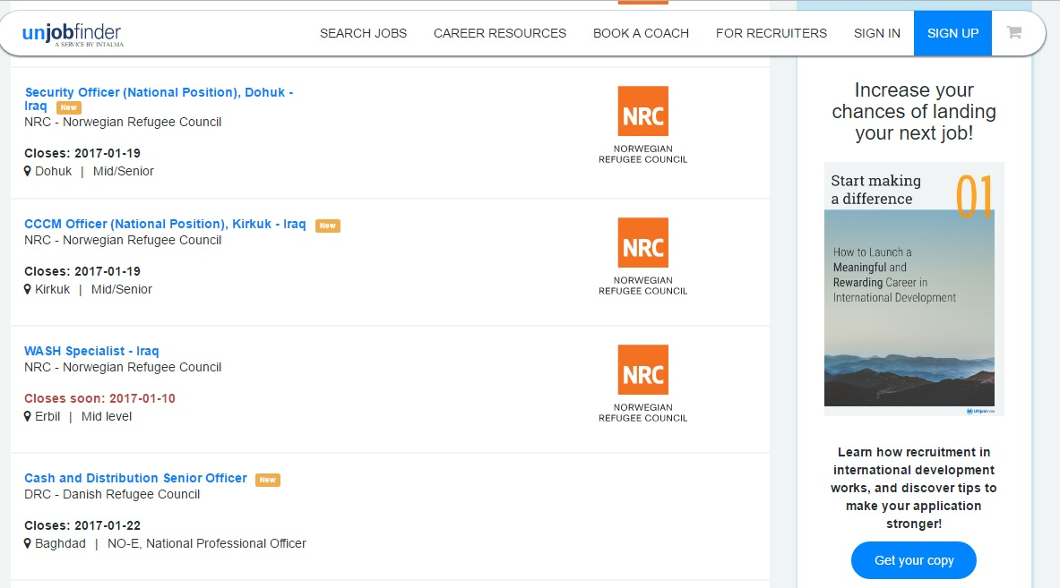

Slide 6
NCCI
Non-Governmental Organization Coordination Committee for Iraq
www.ncci.org
AWEZA
www.aweza.com
Facebooks’ pages

Slide 7
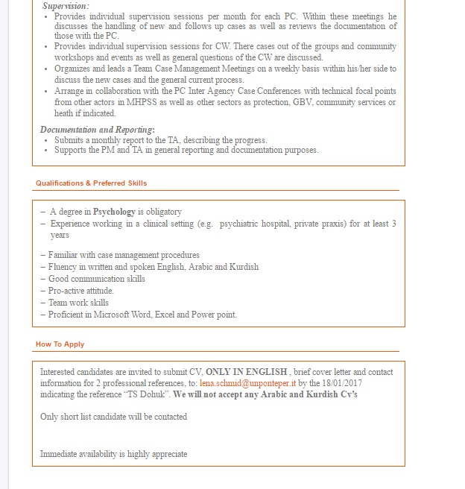
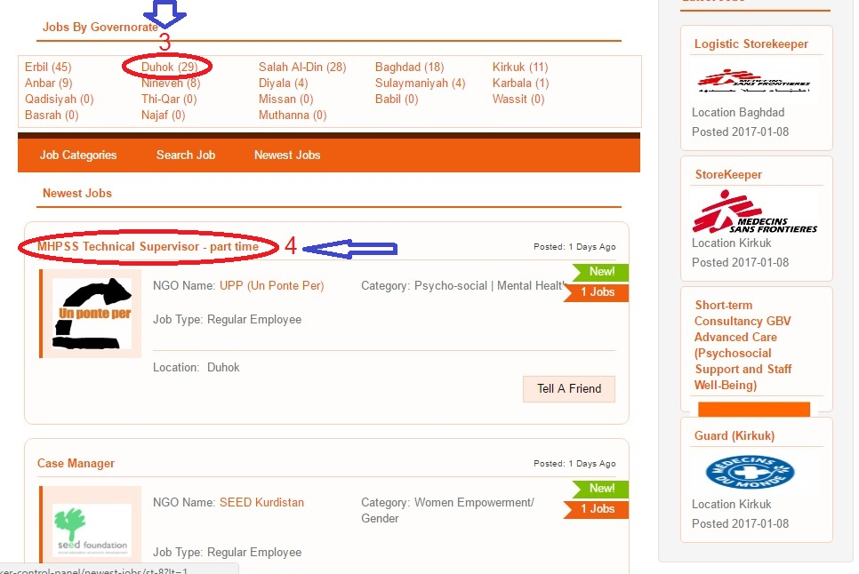

Slide 8
How to apply?
Searching
Cover letter
Curriculum Vitae
Submitting
Introducing
Explaining your purpose
A few of your experiences
Identifying
Education
Work experiences
References

Slide 9
Thank You!

