Slide 1
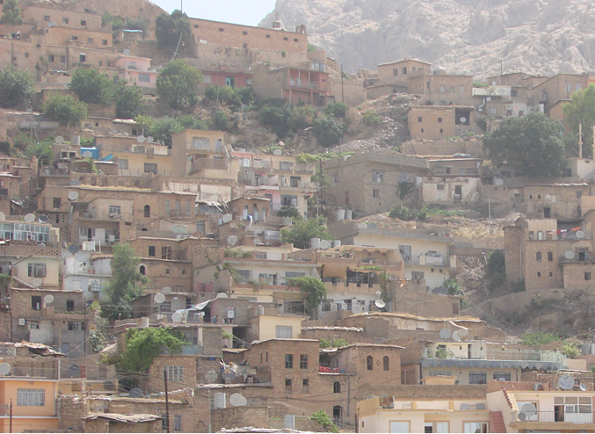
The impact of climatic characteristics on the sustainable design of Mountain building Cities
Akra residential building as a case study
D. Ibrahim Omer Sherkho Raeed S. Ahmed Al - numman
Professor Assistant Lecture

Slide 2
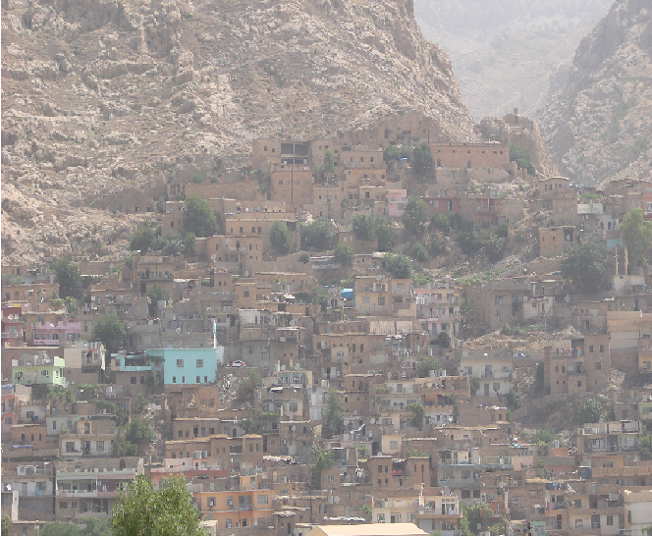
There is no doubt that the concept of sustainability is not a new or innovative term, but rather a concept of its traditional architecture in different throughout the world from ancient times, through experiential compatibility with the environment and efficient exploitation of natural environment resources. The development of experience over the years, architecture was the primary means created by man to protect him from, the conditions of the harsh external environment by exploiting natural energy sources such as sun, wind and soil potential.

Slide 3
The principles of sustainability that interfere with the social organization and the human behavior of the society have been reflected on the urban production both at the level of planning standards of cities and urban clusters or the features of traditional architecture derived from the content of the teachings of Islam and the customs and traditions prevailing in society.
This research aims to define the concept and principles of sustainability in the traditional architecture in general and Especially the buildings of mountain cities, practical section , applied through the analytical of Akra city traditional buildings as a case study..

Slide 4
Research Structure
. Introduction
introduction
Sustainable factors
Planning level
Individual
Unites level
Climatic factors
Sun shin
Wind direction
moisture
Akra is one of the most beautiful cities of Kurdistan with its brilliance, fascination, elegance and unique cultural and archaeological construction. This beautiful city is characterized by its built style at the foot of mountain, which lies on it in the Kurdistan region of Iraq in the 70 km northeast of Mosul, 90 km from the capital Erbil and 110 km Dohuk city. Akra was built in the meadow and located on the slope of its ancient citadel in natural composition such as the Romanian amphitheater.
Analytical study
Results
conclusion
Research case (issue)
Research hypothesis

Slide 5
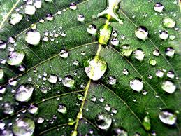
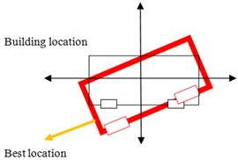
moisture
wind
Sunshine
Controlling moisture is important to protect occupants from adverse health effects and to protect the building,
Difference between two regions causes difference in pressure and the difference in pressure makes wind.
It is usually expressed in hours per year, or in (average) hours per day
Climate main factors
The climate in Kurdistan
The climate of Kurdistan region has been identified according to Koppen classification as arid and semi-arid climate (steppe - BSh and Mediterranean ). It is hot and dry in summer and cold and wet in winter, with short spring and autumn seasons compared to summer and winter [14]. In winter, Kurdistan region falls under the influence of Mediterranean cyclones that moves east to northeast over the region.

Slide 6
Sustainable factors
Planning
factors
Design factors
Faced treatments
(opening)
Roofs treatments
Construction factors

Slide 7
Research case (issue)
Lack of knowledge about the influence of climatic factors in determining in the general characteristics of local architecture in akra city.
Research Hypothesis
The climatic factors are influence in the formation of elements of architectural design and give the functional and expressive impression of the residential architecture of the Akra city, which was characterized by architecture consistent with climatic factors

Slide 8
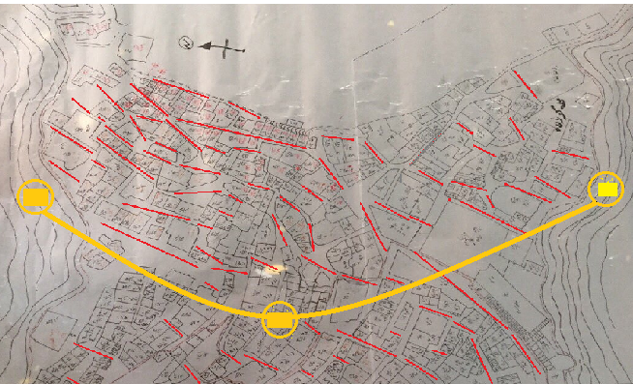
Results of city planning
The planning of Akra city follows the traditional fabric cities planning, with alleys and narrowness streets without open squares. It has a length and zigzag shapes which requires an optimal solution to obtain natural light from the sun as well as ventilation. That led to take a unified direction to the movement form of pedestrian ,
This trend is parallel to the lines of the sun and the common direction of the wind. Then these alleys are naturally conditioned, due it receive the sun throughout the half day. Because if it was perpendicular to the lines of the sun and the direction of the wind it cannot be diluted and receive the sun.

Slide 9
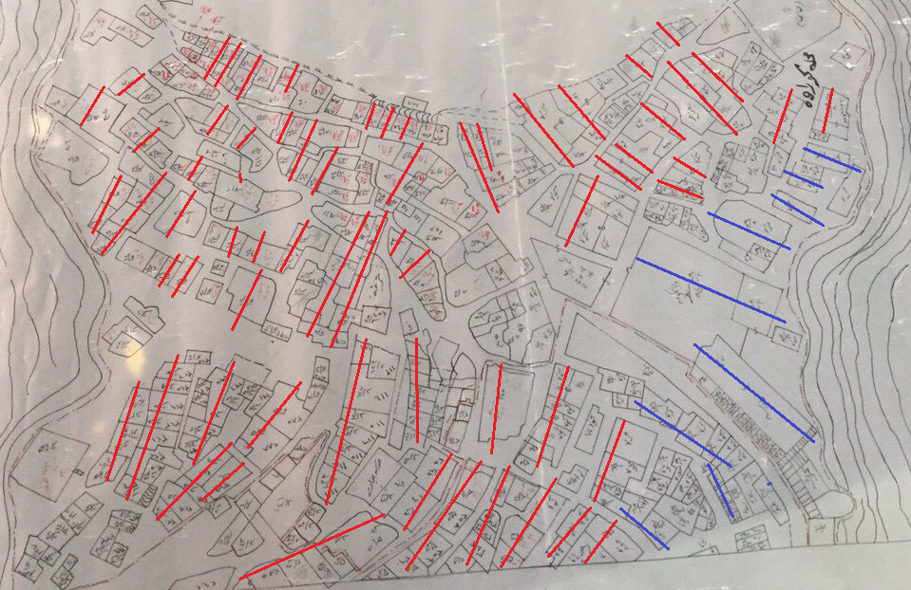
Result of building orientation
The most residential units of Akra city have a best orientation, the main façade of these unites are one of this direction (south, south east, south west) .this orientation is the best for climatic design in Kurdistan region.

Slide 10
Results Design factors
The façades of the buildings in the local building of Akra consist of a group of elements that distinguishes the form and pattern of this architecture from other local buildings. The façades of the buildings belong to the place through the building materials which appear in their natural colors. The elements of the façade define the environmental and construction treatments.
The openings are of great importance in influencing the properties of the visual composition of the facades. The expression differed according to the different buildings.

Slide 11
Building entrances
No. | item | Description
1 | The entrance | The entrance represents the most important architectural elements in the formation of the traditional façade because it is located in the front of the façade, which in turn determines the organization of the elements of the façade within the various levels
Conclusion | The entrance represents the most important architectural elements in the formation of the traditional façade because it is located in the front of the façade, which in turn determines the organization of the elements of the façade within the various levels. The entrance is an opening between( 1m-1.2m) , and its height is between( 160m – 180m ) The entrance doors are made of the finest types of wood and are known as wood door.

Slide 12
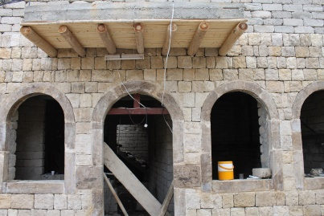
Building windows types
No | item | Description
 | Windows | The window is divided into three main parts (nodes, nets and spikes). The window may contain all or part of these elements.
No. | Item
1 | Windows with shutters:
Conclusion | The shutters give flexibility and control in climatic conditions. They also help privacy. The nets may contain two or more doors. The shutters protect the window from weather fluctuations, close when the rain is opened, and open when needed for ventilation and lighting.

Slide 13
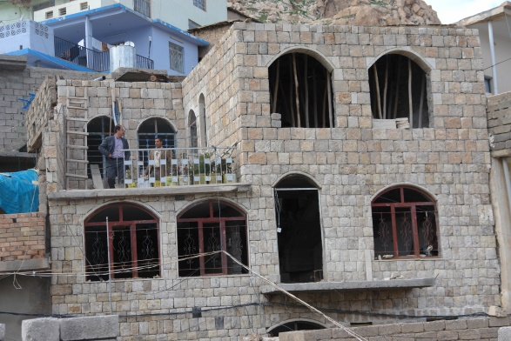
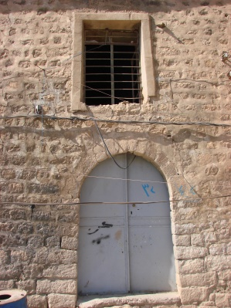
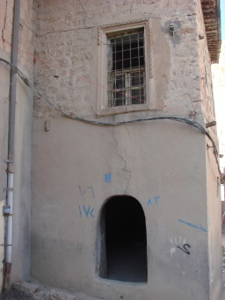
No. | Item
A | Large windows: Used on the upper floors, especially in the reception rooms, and has several functions, they allow access to a large amount of light and enjoy the landscape and allow access to solar radiation
B | The window is a rectangular window with a rectangular lattice. The lower part of the window The purpose of this part Is the ventilation, and there are these types of windows in the upper roles that need to light more, and this type of windows is one of the distinctive elements of the local architecture in the city.

Slide 14
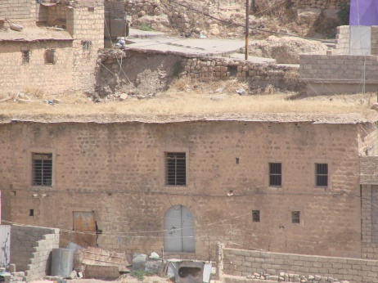
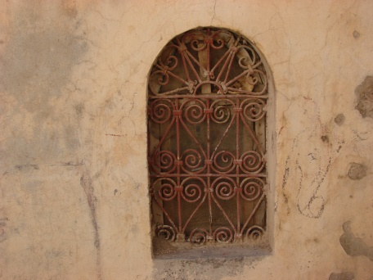
C | A small opening located at a higher level of windows and in a double or individual on both sides of the contract for the window and the purpose of the job to sign in a high level of air regeneration in the interior spaces.
D | False windows False windows or false openings are hollow openings in the wall of about 0.5-0.0 m, consisting of two upper and lower parts or one part and the same dimensions of the above windows, It has two functions: the first is aesthetic, it works to break the boredom in the northern facades, and the second is functional, which is used as wall cabinets inside the rooms.

Slide 15
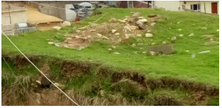
Results of the construction factors
Item
Use the sand roofs
Green roof
Spread legs of the trees which are resistant to the weight to divide the space to be into small areas then put anther legs in different direction, which are wooden chunks of a diameter smaller than the first and then put a substance composed of local soil added to the straw is soft and then harden after the drought where the small gaps fill between the ribs and then Local sandy soils are added with a certain thickness and usually a slight slope to prevent rainwater accumulation. The roofs of the buildings are flat and covered from wood and thatch beam. All these materials have a natural thermal insulation ability.

Slide 16
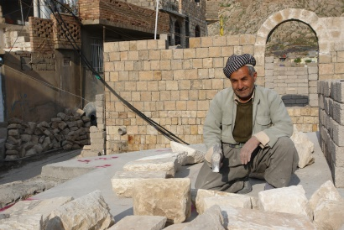
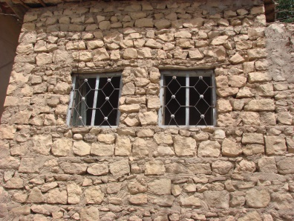
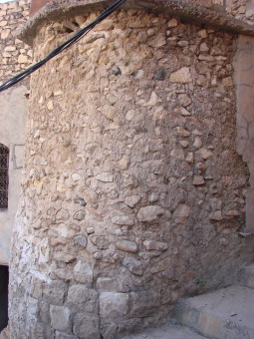
results of Materials
1 | Stone The stone which has been found in the area abundant and has used as a bier or shapes in thick walls in the buildings. In this region, the roofs of the buildings are flat and covered from wood and thatch beam. The bat walls are abundant in this region.
2 | Gypsum (plaster) The mortars that us in built the unites white color from the natural environmental

Slide 17
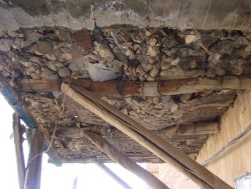
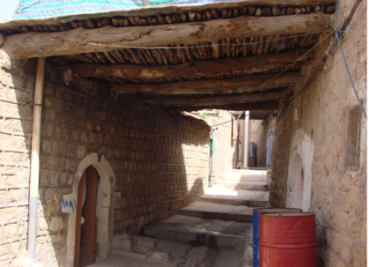
3 | Wood Coverage of its roof and ceiling is from wood bars and thatch. These materials have good heating resistance and capability to keep the heat inside.
 | The stone which has been found in the area abundant and has used as a bier or shapes in thick walls in the buildings.
Conclusion | These materials are the best for a suitable insulation from heat and cold. Keep the temperature and transit it less

Slide 18
7. Conclusion
1. The directions of narrow alleys unified directions to the movement form of pedestrian; this trend is parallel to the lines of the sun and the common direction of the wind. Then these alleys are naturally conditioned
2. The orientation of most residential units in Akra city is the best for climatic design in Kurdistan region, and this is one of the most important solution in the sustainable design .
3. The body of these buildings is from stone, and coverage of its roof and ceiling is from wood bars and thatch. These materials have good heating resistance and capability to keep the heat inside the stone and resistant and heavy materials are used to foundation of the moisture.
4. The buildings of these regions are built in the earth, in these regions , stone buildings make city contexture compatible.

Slide 19
5. The thick walls and flat roofs and covered from wood and sand are the best a suitable insulation from heat and cold, more economic in the mountainous areas cities and compatible with the environment.
6. The façades of residential buildings in the Akra residential building are simple facades. Their elements are organized in a clear and simple system. They are often abandoned in both horizontal and vertical forms. However, there are some added ornaments.
7.The frames around the openings executed from gypsum or Wood to focused the light . while the horizontal bars - from wood - above the windows and stands out from the bearing wall about 20 cm , to protect the wooden windows from rain and shading from the sun and to add more beauty on the facade and They may be simple without any decoration .

Slide 20
8. The façade system in the Aqra city is characterized by simplicity , abstraction without architectural decoration .
9. The frames of entrance openings are built by stones and are headed with a semicircular contract has a small openings to entering the light.
10. false windows are hollow openings in the wall, and it have a aesthetic function , to break the boredom in the facades.
11. A small hole is placed on the top of the semicircle windows in a double or individual way on the sides of the arch and its functional purpose is to renew the air. In the space.
12. The wood is used heavily (it is a natural material Abound at the site)
a. it used for making windows .
b. another kind is used to protect the wooden windows from rainfall and shading them from the sun, while wooden bars are used as amian element in making the sand roofs .

Slide 21
Attention
For
Thanks

