Slide 1
Types of the soil in Duhok city Kurdistan Region – Iraq . by . Dr. Abdulqader Ahmad Hamy 20\12\2015

Slide 2
Introduction :
Duhok city located in the north west of Kurdistan region , between two mountains , Bekher anticline in the north , and Zawa anticline in the south .
According to geological condition , both mountains are composed of Pilaspi formation (limestone ) , and jercus formation presented by clayey silt .
Large parts of the soil in Duhok Basin are covered with clayey silt beds ,that vary in the color from brown to reddish , in addition to it is variable in thickness ,
and affected by erosion process of Bekher and Duhok mountains .
1-The procedure and aim of study :
This study includes field investigation , sampling , laboratory tests , and calculation of allowable bearing capacity .
The aim of study is presenting technical report for purpose of building construction .
Boreholes was drilled by Special Rotary Drilling Machine , the depth ranges (15-25) m. The depth of borehole depend mainly on the height of building , nature of the soil , and engineering geological condition of the site .
During the drilling , S.P.T(Standard Penetration Test) was done , disturbed and undisturbed samples were taken to the laboratory .

Slide 3
Studied area :
the following area were studied :
1- zere land site ( K.R.O ) .
2- Tanahee site : ( Newroz university site) .
3- shakhke site: ( Electric station site).
4- Shandokha site: ( French Village – Sheraton hotel site ) .
5- Azadi panorama ( women's hospital site ).
6- Malta site ( healthy center site ) , south of Roj city .

Slide 4
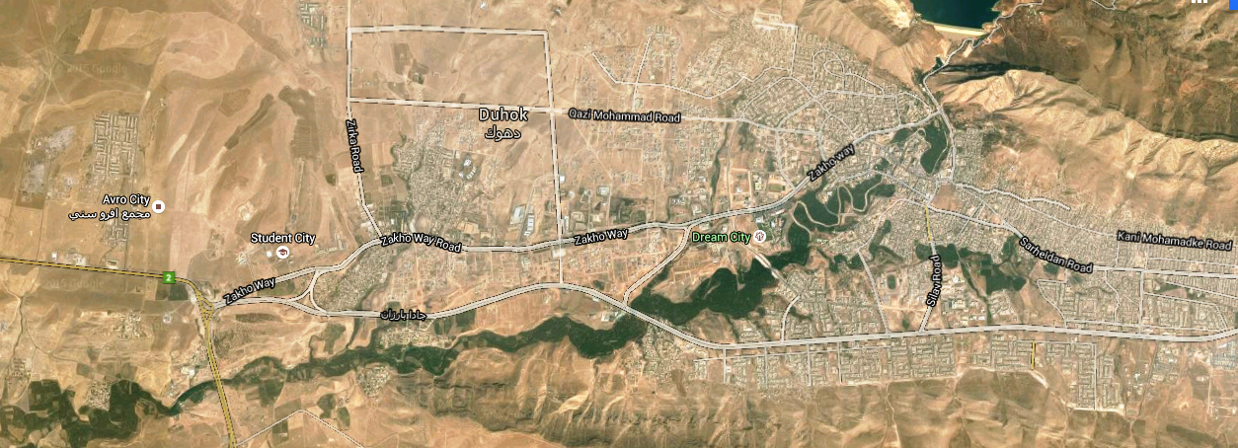
Map of Duhok city with location of studied areas
Shakhky
Shendokha
Malta
Panorama
Zari Land
Nawroz University

Slide 5
Types of the soil in the studied areas according to the Unified Soil Classification System
(U.S.C.S ),
Group 1 , includes : Tanahi , Malta , and Zereland Zone .
1-According to the Unified Soil Classification ( U.S.C.S ), the soil in this group are classified as a CL , CH , Inorganic Clayey Silt , medium to high plasticity , brown to reddish in color . .
2-Laboratory and field data are as follow ,
* Liquid limit (L.L) ranges (43-57)%.
* Index of Plasticity (I.P ) ranges (17-31 )_%
* S.P.T ranges (23-50) N /30 cm .
* Specific gravity (GS) ranges (2.68-2.75) g\sm3
* Allowable Bearing Capacity ranges (15.00-20.00) t\m2
.

Slide 6
Group 2 , includes , Shandokha ,Shakhke .
1- According to U.S.C.S , the soil are classified as a GM , silty calcareous gravel mixture with beds of limestone .
2-Laboratory and field data of this area as follow ,
* Liquid limit (L.L) ranges (22-27)%.
* Index of Plasticity (I.P ) ranges (8-14 )%
* S.P.T ranges (35-50) N /30 cm.
* Specific gravity (GS) ranges (2.72-2.76) g\sm3
* Bearing Capacity (20.00-25.00) t\m2 .

Slide 7
Group 3 : includes : Azadi Panorama Zone . 1-According to U.S.C.S , the soil are classified as a G.P , Poorly Graded , mixture of gravel with sand and fine materials , with beds of conglomerates well to medium cemented . 2- Laboratory and field data are as follow , * - Liquid limit ( L.L ) ranges ( 20-25)%. * - Index of plasticity = ( 6-10) % . * - specific gravity = (2.65-2.67) g\cm3 . * - S. P. T = 50 N\3 cm . * - Bearing capacity ( 25.00 – 30.00) t\m2 .

Slide 8
Conclusion :
according to our investigation , the soil in the studied are suitable for foundations ,
Taking in our consideration that the soil of group 1 classified as a high plasticity , so it may be swelled in case of water existence , in this case replacement of the soil should be done in the site ,
The type of soil replacement should be according to the technical specification ( pure of gypsum , well graded …etc. ) .
Recommendation :
According to the field data , laboratory tests , and our experience , we recommend the following ,
1- Depth of foundation should be executed within the natural soil ( filling or organic soil should be removed ).
2- Transmitted stress to the soil , should be not more than allowable bearing capacity .
3- in case of exist gypsum in the soil , anti sulfate cement should be used in all structural elements contacted with soil .
4- Net of water drainage should be executed according to the specification , whereas s to prevent occurrence of seepage .
5-In case of existence swelling soil (montmorilonite clay ), improvement of soil should be done , such as replacement of the soil .
6- After finishing excavation of the soil foundation , and before concreting soil should be cheeked by Geotechnical Engineer should be checked .

Slide 9
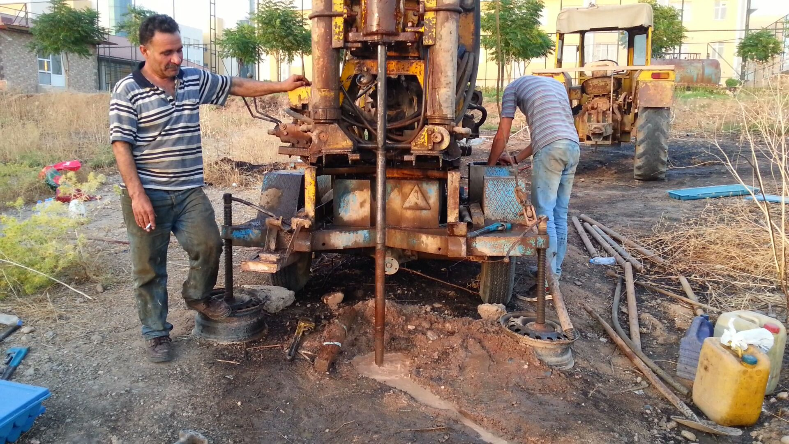

Slide 13
References :
* Soil Mechanics - Yanne Henna Damascus University , Engineering college 1978
* Soil Mechanics @ Foundation Bawls
* Geology of Iraq – jasmine and others
* Laboratory of Duhok
* Hamy .A. archive 2013-2015 , Duhok – Kurdistan Region – Iraq .

Slide 14
Thank you

Slide 15
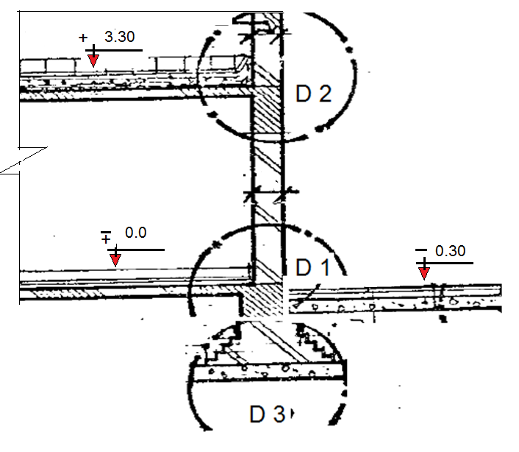

Slide 16
